Slide 1
Course Schedule
Prof. Dr. Dirk Riehle
Friedrich-Alexander University Erlangen-Nürnberg
AMOS A02
Notes:
It is Friedrich-Alexander University Erlangen-Nürnberg – FAU, in short.
Corporate identity wants us to say “Friedrich-Alexander University”.

Slide 2
Course Schedule
# | Class Content | Deliverables
01 | Project introductions | Team contract, T-shirt information
02 | Tools and technologies | Project information, sprint release
03 | Agile software processes | Sprint release, architecture description
04 | Agile product management | Sprint release
05 | Agile software development | Sprint release
06 | Agile quality assurance | Sprint release
07 | Agile process improvement | Mid-project release
08 | Scaling Scrum | Sprint release
09 | Kanban and Lean | Sprint release
10 | Agile architecture | Sprint release
11 | Build systems | Sprint release
12 | Test automation | Sprint release, demo day poster
13 | Continuous deployment | Sprint release
14 | AMOS demo day! | Final release
15 | - | Project summary, retrospectives

Slide 3
Work Rhythm
Lectures
  Class day 10:15-11:45 Uhr
Team meetings
  Class day 12:30-14:00 or 14:15-15:45 Uhr
Project work (self-organized)
  Deliverables due according to schedule

Slide 4
Types of Deliverables 1 / 4
Process artifacts
  All tabs from the planning document
  Quality criteria for process artifacts
    Cleanliness, completeness, correctness
    Understandability and usefulness
    Others more ...

Slide 5
Types of Deliverables 2 / 4
Product artifacts
  Everything in the code repository
  Product artifacts accumulate over time
    What specifically depends on the project, but typically includes
      Source code
      User documentation
      Technical documentation
  Quality criteria for product artifacts
    Cleanliness of source code
    Use of commit comments
    Effective use of branching
    Correct tags and releases
    Sufficient test coverage
    Others more …

Slide 6
Types of Deliverables 3 / 4
Stand-up emails
  A short summary email through https://uni1-happy.appspot.com containing
    What you did since the last email
    What problems you encountered
    What you are going to do next
  Expected minimum frequency
    Product owner role: Max. one per day, in total two per week
    Software developer role: Max one per day, in total three per week

Slide 7
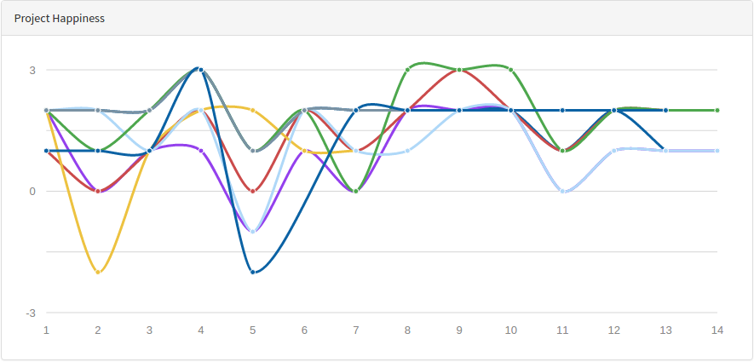
Types of Deliverables 4 / 4
Happiness index
  Provide feedback through https://uni1-happy.appspot.com

Slide 8
Time of Day for Deliverables
Process artifacts
  Before team meeting (noon on team meeting day)
Product artifacts
  Middle of team meeting (after prior sprint, before new sprint)
Stand-up emails
  Midnight every day
Happiness index
  Middle of team meeting (after prior sprint, before new sprint)
Everything else
  End of team meeting day

Slide 9
CW #01 Deliverables
Provide happiness index during team meeting
Submit team contract (as PDF-scan through StudOn)
  More information at https://wp.me/PDU66-1su
Submit information for team T-shirts (through StudOn)
  Submit high-resolution (300dpi) team logo
  Provide T-shirt preferences using https://goo.gl/forms/hkakbtJJpUjBHJQP2
This week only: Due date/time is Friday midnight

Slide 10
CW #02 Deliverables
Submit project setup information (by email to teaching team)
  Include link to Github repository, call it amos-ss1X-projY
  Include link to public planning documents
    Copy and adapt from http://goo.gl/Brc0Q
    Set sharing to public (viewable) so teaching team can view
Submit process artifacts (as PDF through StudOn)
  Follow instructions at https://goo.gl/qoVtFA
  Plan out student roles and industry partner meetings for whole semester
Tag product artifacts on Github and deploy them
  Tag is sprint-01-release (continue like this in the future)
Provide stand-up emails and happiness index

Slide 11
CW #03 Deliverables
Submit process artifacts, include (new)
  Initial bill of materials
    Please keep maintaining it over time
Provide product artifacts as before
Submit software architecture description (as PDF through StudOn)
  High-level logical and code component overview
  Employed technology stack and platforms
Provide stand-up emails and happiness index

Slide 12
CW #04 Deliverables
Submit process artifacts
Provide product artifacts
Provide stand-up emails
Provide happiness index

Slide 13
CW #05 Deliverables
Submit process artifacts
Provide product artifacts
Provide stand-up emails
Provide happiness index

Slide 14
CW #06 Deliverables
Submit process artifact, include (new)
  Mid-term release plan
  Definition-of-done for both
    Sprint release
    Product release
Provide product artifact
Provide stand-up emails
Provide happiness index

Slide 15
CW #07 Deliverables
Submit process artifacts, include (new)
  Final product release plan
Provide product artifacts
  Mid-project product release (tagged on Github)
  Mid-project product documentation (tagged on Github)
  Mid-project product deployed as appropriate for the project
  Use additional release tag mid-project-release
Provide stand-up emails
Provide happiness index

Slide 16
CW #08 Deliverables
Submit process artifacts
Provide product artifacts
Provide stand-up emails
Provide happiness index

Slide 17
CW #09 Deliverables
Submit process artifacts
Provide product artifacts
Provide stand-up emails
Provide happiness index

Slide 18
CW #10 Deliverables
Submit process artifacts
Provide product artifacts
Provide stand-up emails
Provide happiness index

Slide 19
CW #11 Deliverables
Submit process artifacts
Provide product artifacts
Provide stand-up emails
Provide happiness index

Slide 20
CW #12 Deliverables
Submit AMOS demo day poster (as PDF through StudOn)
  Submit high-resolution (300dpi) PDF for DinA1 printing
  The poster will be part of your demo booth; it should provide
    Team name, team logo, industry partner name, project description
    Software architecture description, example use cases
Submit process artifacts
Provide product artifacts
Provide stand-up emails
Provide happiness index

Slide 21
CW #13 Deliverables
Submit process artifacts
Provide product artifacts
Provide stand-up emails
Provide happiness index

Slide 22
CW #14 Deliverables
Submit process artifacts in final cleaned-up version
Provide product artifacts, includes (new)
  Final product release (tagged on Github)
    Additional release tag is final-project-release
Provide stand-up emails
Provide happiness index

Slide 23
CW #15 Deliverables
Provide a project summary (by sharing with Prof. Riehle)
  Copy and fill in the form at https://goo.gl/qLiZLA
  Share with riehle@group.riehle.org
Provide an individual retrospective (as PDF through StudOn)
  Answer in (max.) one page
    What worked well?
    What did not work well?
    How to do better next time?
  Feel free to provide additional feedback on the course

Slide 24
Thank you! Questions?
dirk.riehle@fau.de – http://osr.cs.fau.de
dirk@riehle.org – http://dirkriehle.com – @dirkriehle
DR

Slide 25
Credits and License
Original version
  © 2012-2016 Dirk Riehle, all rights reserved
Contributions
  ...

